Slide 1

From fibroblast to neuron: A transcriptomic analysis neuroregeneration
Presented by:
Pragathi Prasad, Dept of Biotechnology, PES University
Guided by:
Dr. SV Reshma, Dept of Biotechnology, PES University

Slide 2
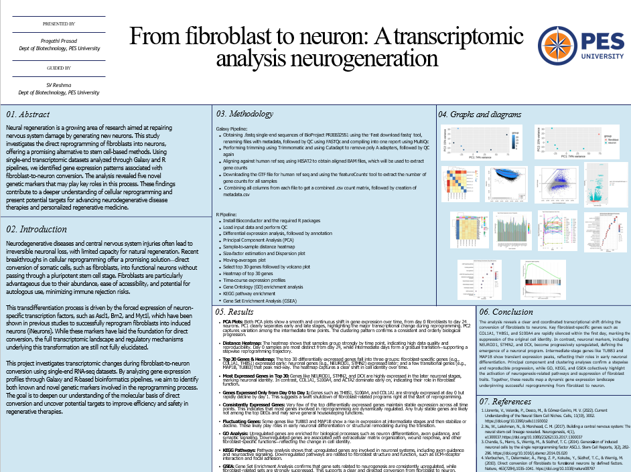

Slide 3
Content
Introduction
Previously discovered genes and factors
About dataset
Galaxy pipeline
R pipeline
Results
Conclusion

Slide 4
Introduction
Neural regeneration aims to synthesize new neurons and neural connections to treat conditions like spinal cord injuries, Parkinson’s disease, and brain cancer. Techniques like neuronal transplants and stem cell grafting are being explored.
Isolating neural stem cells is costly and complex, limiting their clinical application. As a result, alternative cell sources such as blood, bone marrow, astrocytes, and fibroblasts are being investigated.
Fibroblasts are connective tissue cells that secrete collagen and maintain structural integrity. They are easily extracted from the body and present a promising, low-risk option for generating neurons.
Through direct reprogramming with neural transcription factors, fibroblasts can be converted into induced neurons (iNeurons) without becoming pluripotent. This project explores transcriptomic changes during this process to identify key genes driving the conversion.

Slide 5
Previously implicated factors
ASCL1 – A pioneer transcription factor that binds closed chromatin and initiates neuronal gene expression; it can independently induce neuronal features in fibroblasts.
BRN2 (POU3F2) – Works with ASCL1 and MYT1L to promote neuronal differentiation and maturation, enhancing the functional properties of induced neurons.
MYT1L – Reinforces neuronal identity by repressing fibroblast and glial gene expression, stabilizing the reprogrammed neuronal state.
miR-124 & miR-9/9* – Neuron-specific microRNAs that remodel chromatin and suppress non-neuronal genes, critical for efficient fibroblast-to-neuron conversion.
NGN2 (Neurogenin 2) – A potent bHLH (basic Helix-Loop-Helix), transcription factor capable of directly converting fibroblasts into excitatory neurons by activating key neuronal genes.

Slide 6
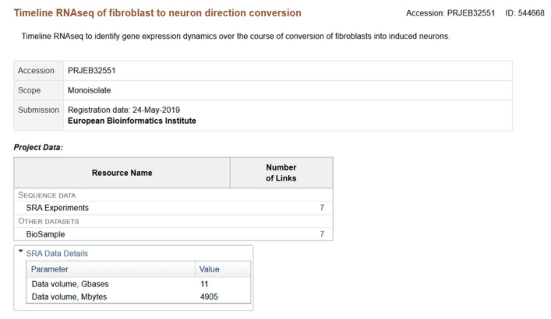
Dataset identification

Slide 7
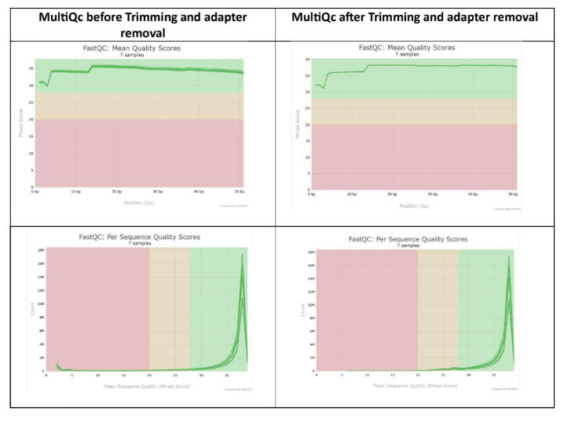
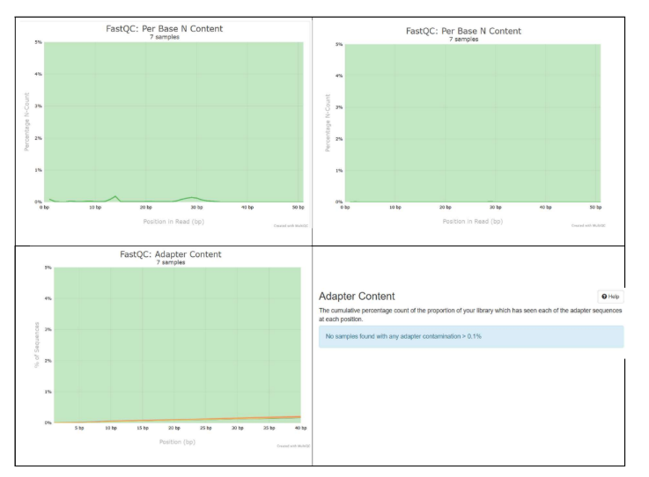
Galaxy pipeline
The SRA files were downloaded in the form of single end .fastq files using the ‘Fast download FASTQ’ tool. The were renamed with appropriate metadata (i.e day of sequencing)
The FASTQc reports were generated for each of the files and compiled to generate single MultiQc report.

Slide 8
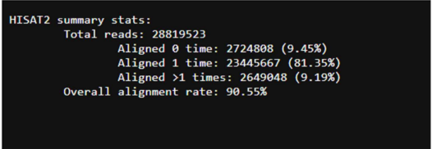
Galaxy pipeline
HISAT2 was used to align the sequences against the human reference genome hg38. The overall alignment was found to be >90% for forward, reverse and unstranded in strandedness, therefore the sequences are assumed to be unstranded

Slide 9
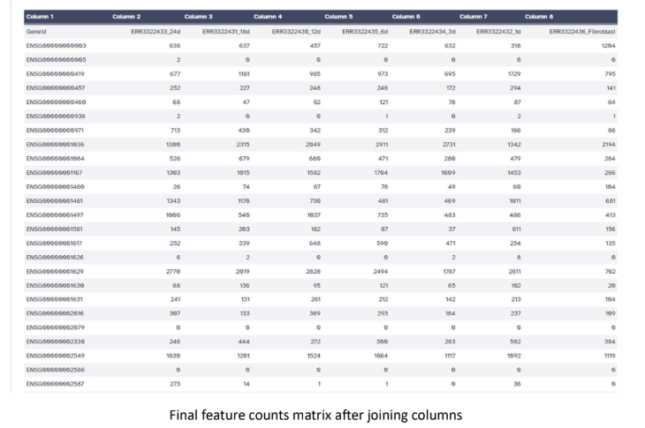
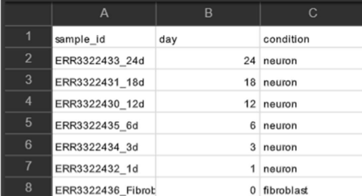
Galaxy pipeline
The gene transfer file (GTF file) was downloaded from ENSEMBL and loaded onto the galaxy server to create the count matrix.
The ‘featurecounts’ tool was used to create a count matrix for each individual aligned BAM file and the ‘Column join’ tool was used to create a combined feature count matrix.
A metadata.csv file was created manually.
Metadata.csv

Slide 10
R pipeline
Loading Packages: Bioconductor and required packages like DESeq2, limma, pheatmap, etc., were loaded for analysis.
Reading Data: Raw gene count matrix and sample metadata were imported from CSV files.
Creating DESeq2 Object: Counts and metadata were combined into a dds object to model gene expression by condition.
Filtering Low-Count Genes: Genes with very low overall counts were removed to retain only informative genes (e.g., rowSums ≥ 10).
Running DESeq2: DESeq2’s core pipeline performed normalization, dispersion estimation, and differential expression analysis.
Extracting Results: Genes with adjusted p < 0.05 were selected; ~7.7% upregulated, 4.3% downregulated, ~120 outliers, and ~55% had very low counts.

Slide 11
R pipeline
PCA Plot: Performed to explore sample clustering based on both time and condition, allowing visualization of whether samples form trajectories over time or separate distinctly by treatment in the PCA space.
Sample Heatmap: Constructed to show how samples group based on overall gene expression, helping verify if replicates cluster together and if time or condition leads to clear expression shifts.
Size & Dispersion Estimation: Size factor estimation normalized for differences in sequencing depth between samples. The dispersion plot assessed gene expression variability across replicates, which is essential for accurate differential expression testing.
Top Genes Selection: The top 30 genes were selected based on the lowest adjusted p-values (padj), representing the most statistically significant expression changes in the dataset.
Volcano Plot: Created to visualize both the magnitude (log2 fold change) and significance (–log10 p-value) of gene expression changes, helping identify genes that are both highly differentially expressed and statistically reliable.
Second Heatmap: Showed expression levels of the top 30 significant genes across all samples, revealing patterns of up/downregulation and helping interpret how expression shifts with time or treatment.

Slide 12
R pipeline
Graphs were plotted to visualize the expression levels of the top 30 genes over the period of 24 days
GO (Gene Ontology) analysis was done to identify biological processes, cellular components, and molecular functions enriched among the differentially expressed genes.
KEGG pathway analysis helped reveal which biological pathways (e.g., signaling or metabolic) are significantly involved in the fibroblast-to-neuron conversion.
GSEA (Gene Set Enrichment Analysis) was used to assess whether predefined gene sets show statistically significant, coordinated differences in expression across the whole dataset, even if individual genes aren't highly significant.

Slide 13
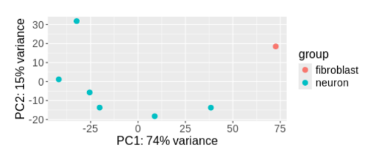
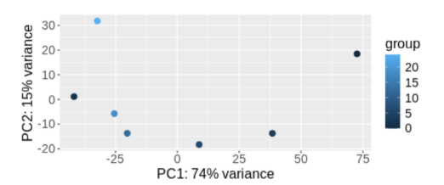
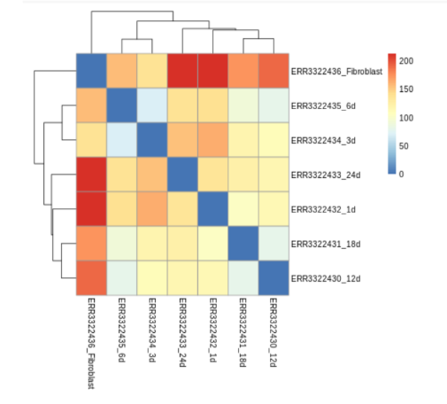
Results
PCA in time space
PCA in condition space
PCA distance matrix

Slide 14
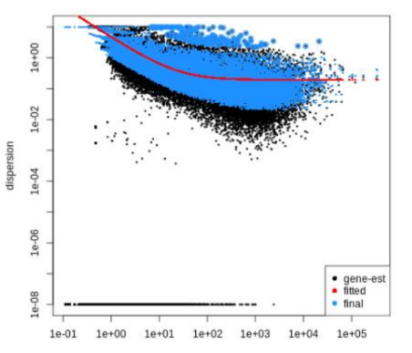
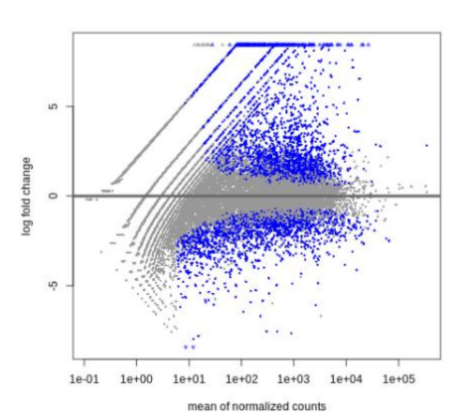
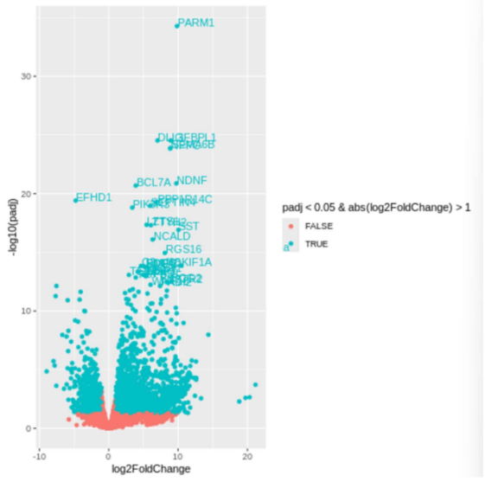
Results
Dispersion plot
MA plot
Volcano plot

Slide 15
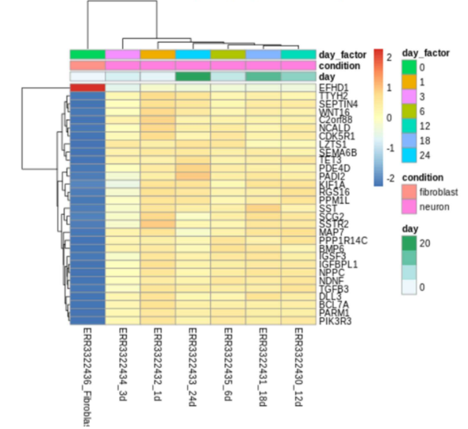
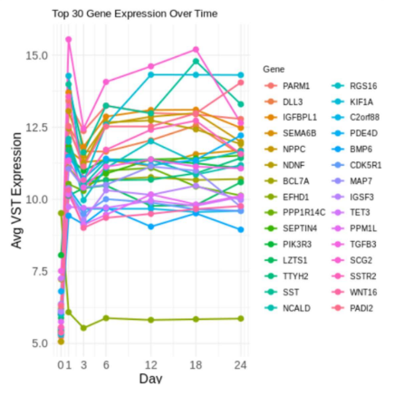
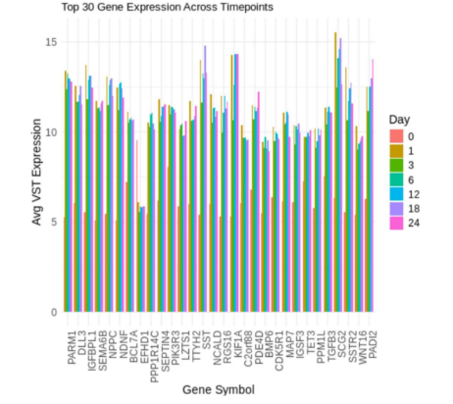
Results
Top 30 genes' expression plotted against time (day)
Heatmap relating genes

Slide 16
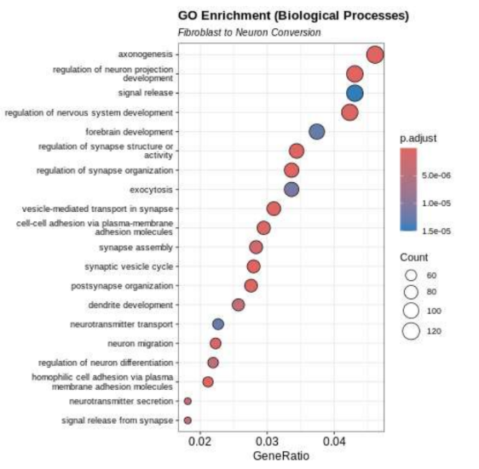
Results

Slide 17
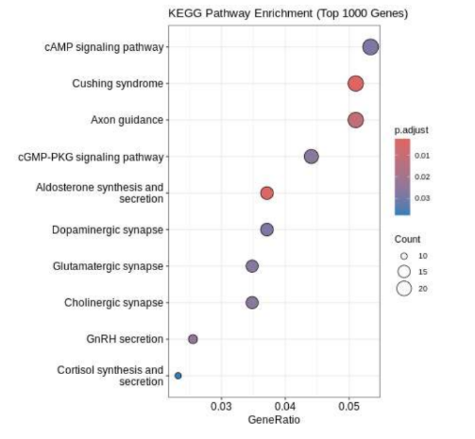
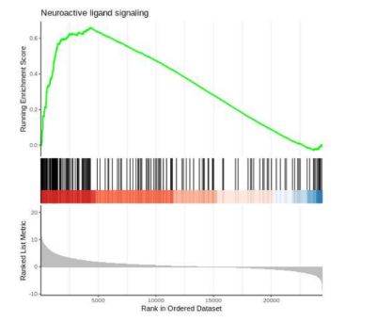
Results

Slide 18
Results
A sharp increase in expression for most genes between Day 0 and Day 1, followed by stabilization or gradual elevation through Day 24. Notably, genes such as IGFBPL1, IGSF3, SEMA6B, NPPC, and TGFβ3 exhibit the highest average VST (Variance Stabilizing Transformation) expression levels across the time course, consistently maintaining values around or above 13–15. These genes show sustained high expression from early stages onward.
Genes like NEUROD1, STMN2, and DCX are highly expressed in the later neuronal stages, marking neuronal identity. In contrast, COL1A1, S100A4, and ACTA2 dominate early on, indicating their role in fibroblast function.
Very few of the top differentially expressed genes maintain stable expression across all time points. This indicates that most genes involved in reprogramming are dynamically regulated. Any truly stable genes are likely not among the top DEGs and may serve general housekeeping functions.
Genes such as THBS1, S100A4, and COL1A1 are strongly expressed at day 0 but rapidly decline by day 1. This suggests a swift shutdown of fibroblast-related programs right at the start of reprogramming.
Upregulated genes are enriched for biological processes such as neuron differentiation, axon guidance, and synaptic signaling. Downregulated genes are associated with extracellular matrix organization, wound response, and other fibroblast-specific functions—reflecting the change in cell identity.
Pathway analysis shows that upregulated genes are involved in neuronal systems, including axon guidance and neuroactive signaling. Downregulated pathways are related to fibroblast structure and function, such as ECM-receptor interaction and focal adhesion.
Gene Set Enrichment Analysis confirms that gene sets related to neurogenesis are consistently upregulated, while fibroblast-related sets are strongly suppressed. This supports a clear and directed conversion from fibroblast to neuron.

Slide 19
Conclusion
The transcriptomic data confirms a clear transition from fibroblast to neuronal identity, marked by suppression of fibroblast genes and activation of neuronal markers.
Differential expression and GSEA revealed enrichment in neurogenesis, axon guidance, and synaptic signaling pathways, validating the biological direction of reprogramming.
Most genes showed time-dependent expression changes, highlighting the tightly regulated and staged nature of neuronal reprogramming.
Increasing dataset size, integrating different omic data can help gain a better understanding of gene and protein expression patterns that can be tweak to induce fibroblast to neuron conversion

Slide 20
References
Chanda, S., Marro, S., Wernig, M., & Südhof, T. C. (2014). Generation of induced neuronal cells by the single reprogramming factor ASCL1. Stem Cell Reports, 3(2), 282–296. https://doi.org/10.1016/j.stemcr.2014.05.020
Vierbuchen, T., Ostermeier, A., Pang, Z. P., Kokubu, Y., Südhof, T. C., & Wernig, M. (2010). Direct conversion of fibroblasts to functional neurons by defined factors. Nature, 463(7284), 1035–1041. https://doi.org/10.1038/nature08797
Zhang, Y., Pak, C., Han, Y., Ahlenius, H., Zhang, Z., Chanda, S., ... & Südhof, T. C. (2013). Rapid single-step induction of functional neurons from human pluripotent stem cells. Neuron, 78(5), 785–798. https://doi.org/10.1016/j.neuron.2013.05.029
Wang, X., Wu, J., Wang, W., Zhang, Y., He, D., Xiao, B., Zhang, H., Song, A., Xing, Y., & Li, B. (2022). Reprogramming of rat fibroblasts into induced neurons by small-molecule compounds in vitro and in vivo. ACS Chemical Neuroscience, 13(14), 2099–2109. https://doi.org/10.1021/acschemneuro.2c00078
Carter, J. L., Halmai, J. A. N. M., & Fink, K. D. (2020). The iNs and outs of direct reprogramming to induced neurons. Frontiers in Genome Editing, 2, 7. https://doi.org/10.3389/fgeed.2020.00007
Xu, Z., Su, S., Zhou, S., Yang, W., Deng, X., Sun, Y., Li, L., & Li, Y. (2020). How to reprogram human fibroblasts to neurons. Cell & Bioscience, 10, 76. https://doi.org/10.1186/s13578-020-00476-2
Wang, X., Wu, J., Wang, W., Zhang, Y., He, D., Xiao, B., ... & Li, B. (2022). Reprogramming of rat fibroblasts into induced neurons by small-molecule compounds in vitro and in vivo. ACS Chemical Neuroscience, 13(14), 2099–2109. https://doi.org/10.1021/acschemneuro.2c00078
Qin, H., Zhao, A. D., Sun, M. L., Ma, K., & Fu, X. B. (2020). Direct conversion of human fibroblasts into dopaminergic neuron-like cells using small molecules and protein factors. Military Medical Research, 7, 52. https://doi.org/10.1186/s40779-020-00284-2
Ding, S., Liu, Y., & Liu, M. (2021). Direct conversion of adult fibroblasts into motor neurons. STAR Protocols, 2(4), 100973. https://doi.org/10.1016/j.xpro.2021.100973
Habekost, M., Jørgensen, A. L., Qvist, P., & Denham, M. (2020). Reprogramming human adult fibroblasts into GABAergic interneurons. Cells, 9(12), 3450. https://doi.org/10.3390/cells9123450
Ryu, J., Hwang, N. S., & Park, H. H. (2020). Protein-based direct reprogramming of fibroblasts to neuronal cells using 30Kc19 protein and transcription factor Ascl1. International Journal of Biochemistry & Cell Biology, 121, 105717. https://doi.org/10.1016/j.biocel.2020.105717
Liu, M. L., Zang, T., Zou, Y., Chang, J. C., Gibson, J. R., Huber, K. M., & Zhang, C. L. (2013). Small molecules enable Neurogenin 2 to efficiently convert human fibroblasts into cholinergic neurons. Nature Communications, 4, 2183. https://doi.org/10.1038/ncomms3183

Slide 21
Thank you

